Slide 1
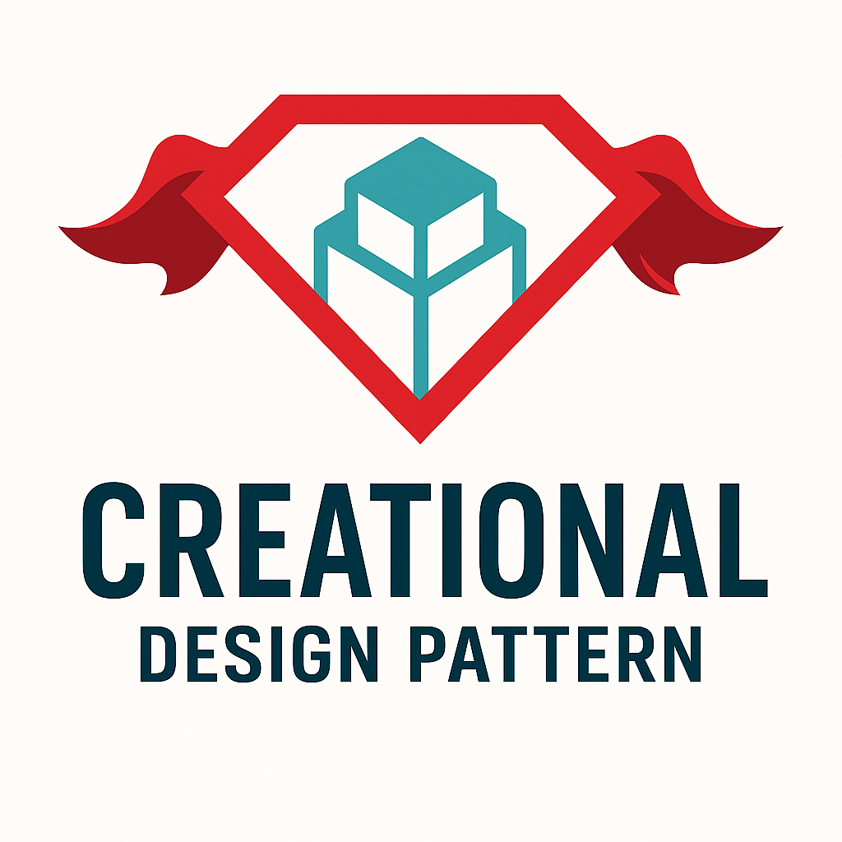
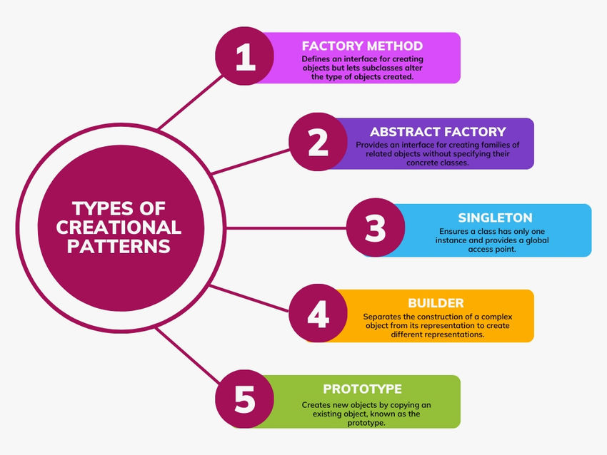
What is Creational Design Patterns?
Creational design patterns address object creation and instantiation, aiming to make a system independent of how objects are created and represented. They provide flexible and efficient solutions for handling object creation, reducing complexities and increasing code reusability.

Slide 2

SINGLETON Singleton is a creational design pattern that lets you ensure that a class has only one instance, while providing a global access point to this instance.
Problem
The Singleton pattern solves two problems at the same time, violating the Single Responsibility Principle:
Ensure that a class has just a single instance.
Provide a global access point to that instance.

Slide 3
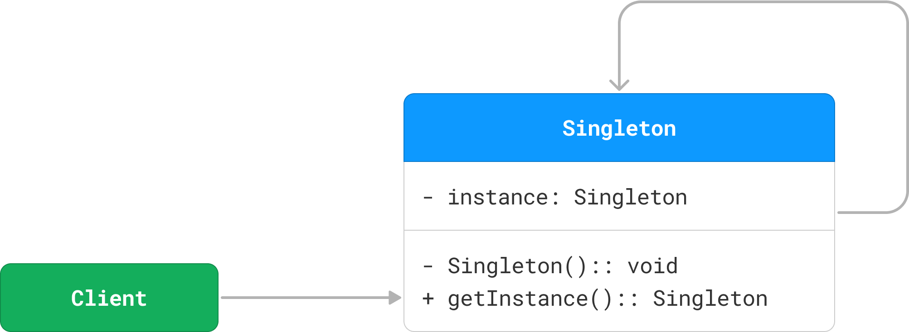
Implementation
To implement the singleton pattern, we must prevent external objects from creating instances of the singleton class. Only the singleton class should be permitted to create its own objects.
Additionally, we need to provide a method for external objects to access the singleton object.
This can be achieved by making the constructor private and providing a static method for external objects to access it.
Lazy Initialization
Thread-Safe Singleton
Double-Checked Locking
Eager Initialization
Bill Pugh Singleton
Enum Singleton
Static Block Initialization
Use Cases
Database Connections
Loggers
Thread Pools

Slide 4
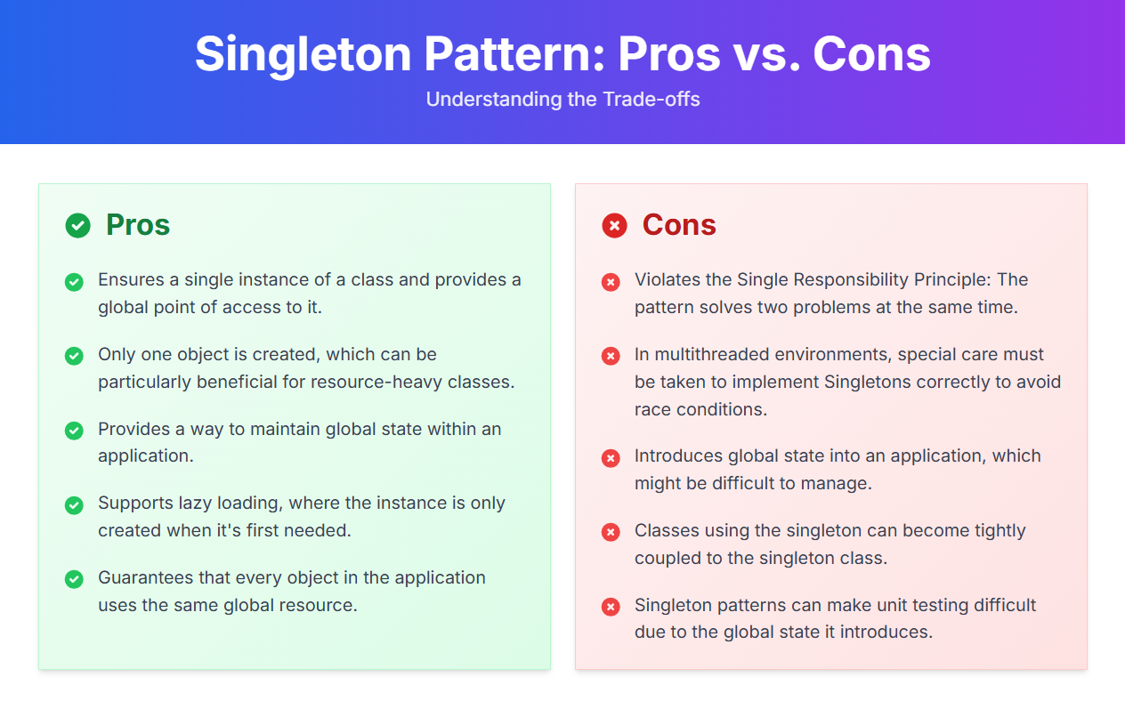

Slide 5
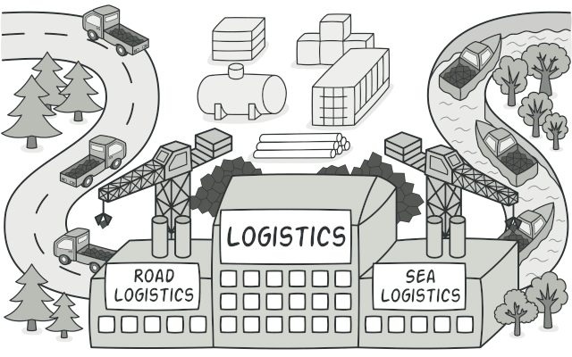
FACTORY METHOD Factory Method is a creational design pattern that provides an interface for creating objects in a superclass, but allows subclasses to alter the type of objects that will be created.
When to Use
When you don’t know in advance what class of object you need.
When you want to delegate the instantiation to subclasses.
When you want to avoid tight coupling between creator and concrete classes.
Key Concepts
Defines an interface or abstract class for creating an object.
Subclasses decide which class to instantiate.
Promotes loose coupling and open/closed principle (OCP of SOLID).

Slide 6
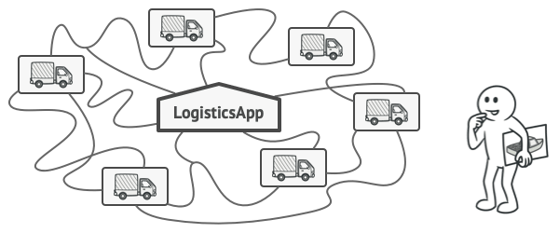
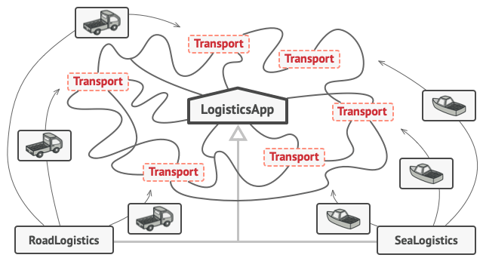
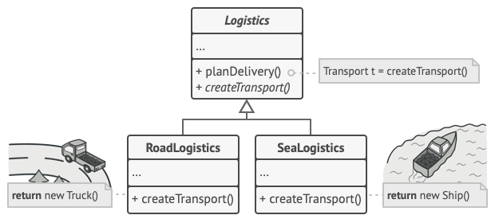
Problem & Solution
Imagine that you’re creating a logistics management application. The first version of your app can only handle transportation by trucks, so the bulk of your code lives inside the Truck class.
After a while, your app becomes pretty popular. Each day you receive dozens of requests from sea transportation companies to incorporate sea logistics into the app.
The Factory Method pattern suggests that you replace direct object construction calls (using the new operator) with calls to a special factory method.

Slide 7
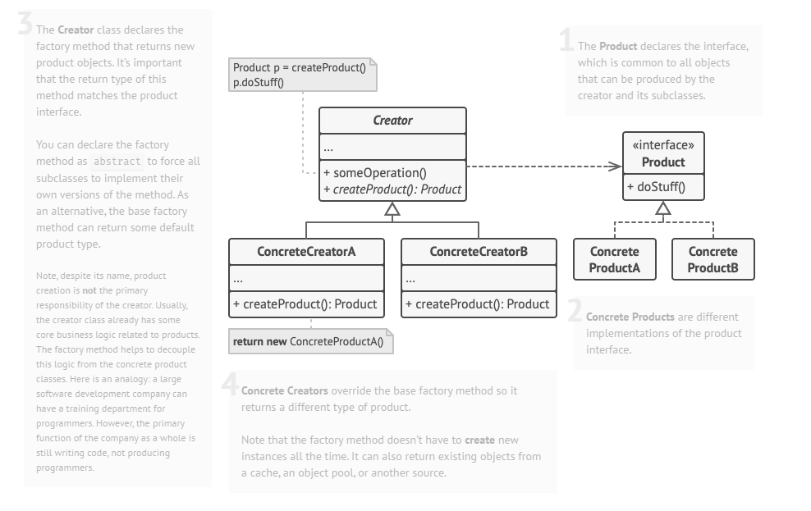
Structure

Slide 8
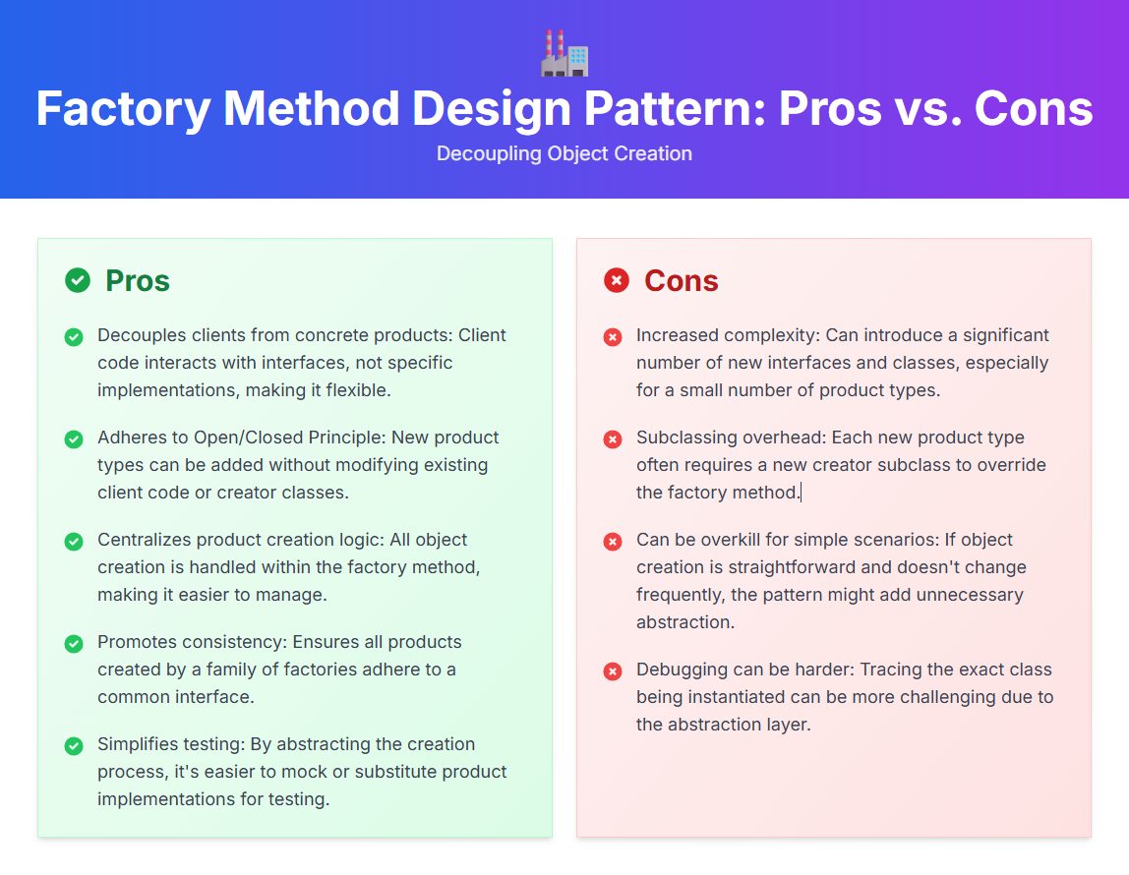

Slide 9
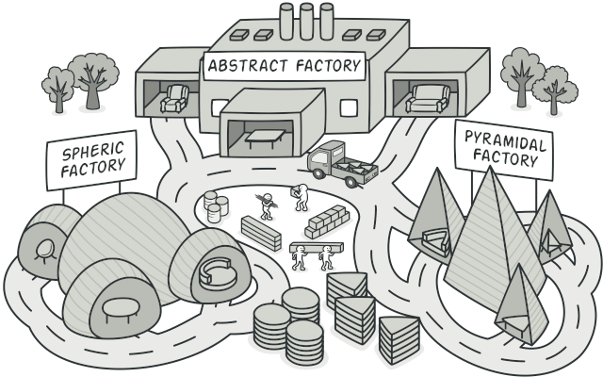
ABSTRACT FACTORY Abstract Factory is a creational design pattern that lets you produce families of related objects without specifying their concrete classes.
Applicability
Use the Abstract Factory when your code needs to work with various families of related products, but you don’t want it to depend on the concrete classes of those products—they might be unknown beforehand or you simply want to allow for future extensibility.
The Abstract Factory provides you with an interface for creating objects from each class of the product family. As long as your code creates objects via this interface, you don’t have to worry about creating the wrong variant of a product which doesn’t match the products already created by your app.
Use cases: GUI Elements like buttons, checkbox.

Slide 10
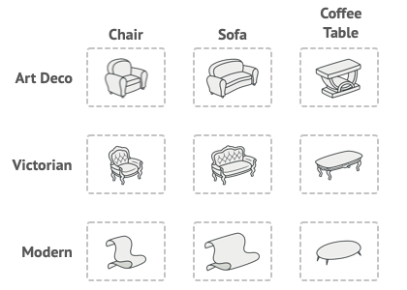
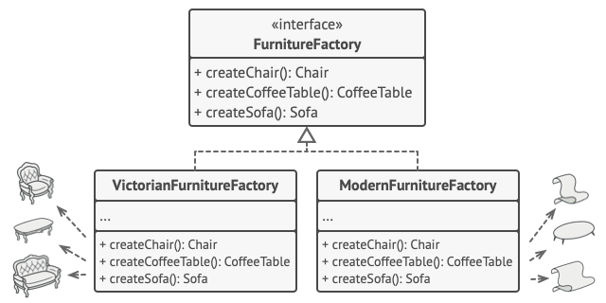
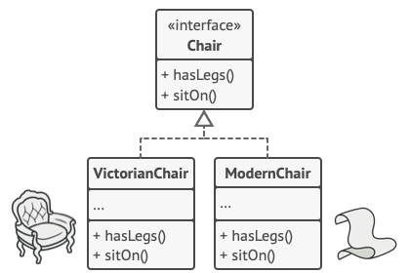
Problem & Solution
Imagine that you’re creating a furniture shop simulator. Your code consists of classes that represent:
A family of related products, say: Chair + Sofa + CoffeeTable.
Several variants of this family. For example, products Chair + Sofa + CoffeeTable are available in these variants: Modern, Victorian, ArtDeco.
The first thing the Abstract Factory pattern suggests is to explicitly declare interfaces for each distinct product of the product family (e.g., chair, sofa or coffee table). Then you can make all variants of products follow those interfaces. For example, all chair variants can implement the Chair interface; all coffee table variants can implement the CoffeeTable interface, and so on.

Slide 11
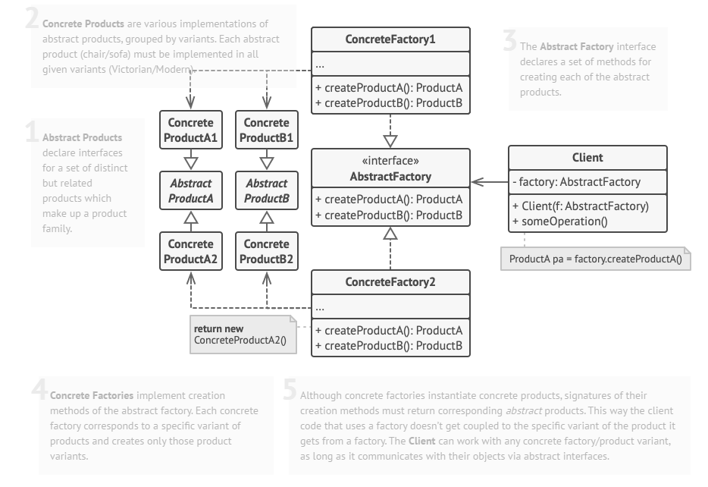
Structure

Slide 12
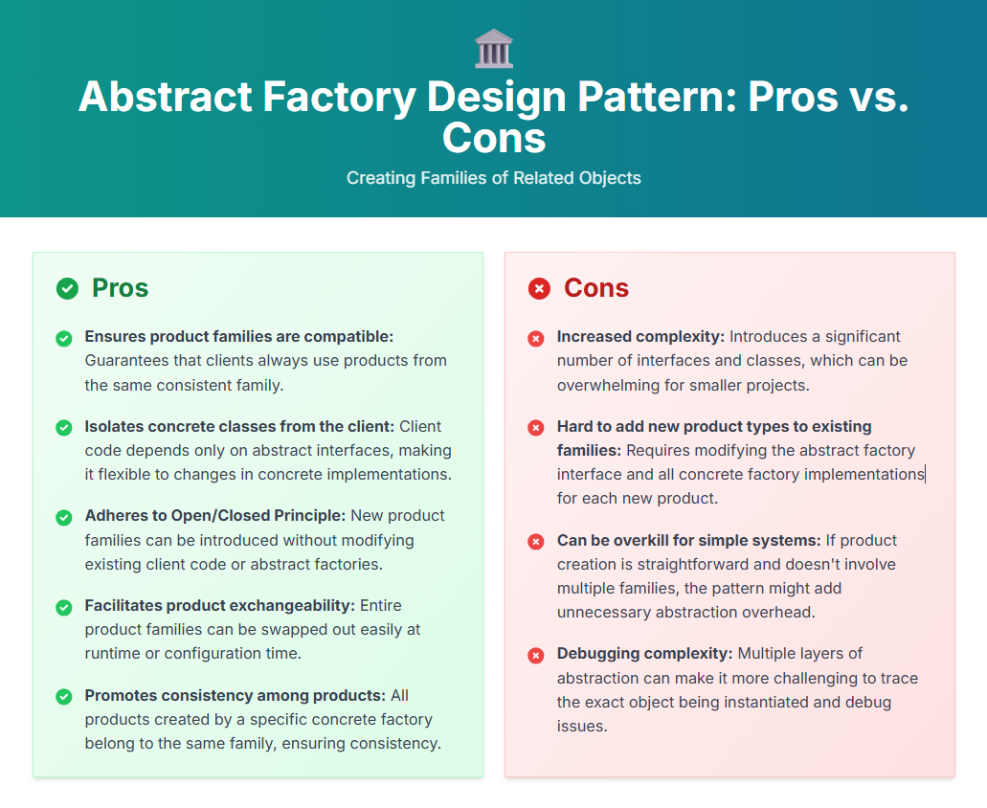

Slide 13
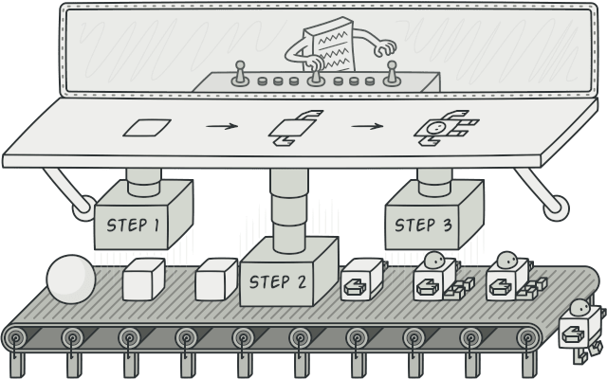
BUILDER Builder is a creational design pattern that lets you construct complex objects step by step. The pattern allows you to produce different types and representations of an object using the same construction code.
Applicability
Use the Builder pattern to get rid of a “telescoping constructor”.
Use the Builder pattern when you want your code to be able to create different representations of some product (for example, stone and wooden houses).
Use the Builder to construct Composite trees or other complex objects.
Use cases: to create complex objects with a large number of optional components or configurations.

Slide 14
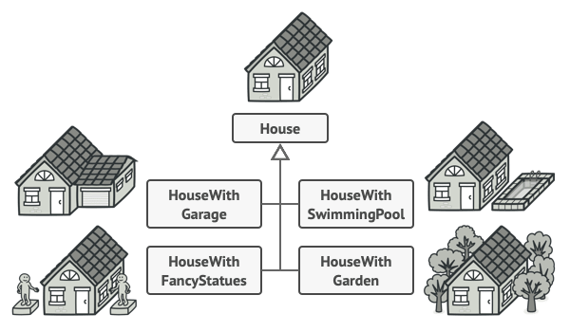
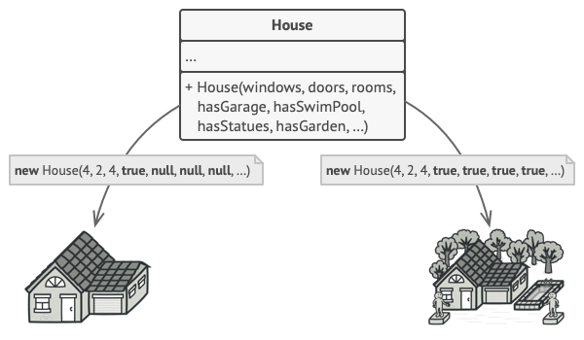
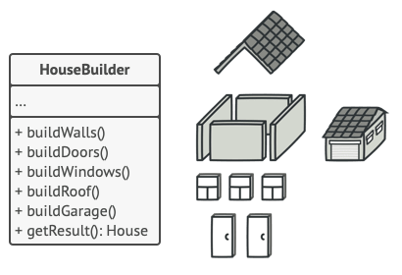
Problem & Solution
Imagine a complex object that requires laborious, step-by-step initialization of many fields and nested objects. Such initialization code is usually buried inside a monstrous constructor with lots of parameters. Or even worse: scattered all over the client code.
The Builder pattern suggests that you extract the object construction code out of its own class and move it to separate objects called builders.
The pattern organizes object construction into a set of steps (buildWalls, buildDoor, etc.). To create an object, you execute a series of these steps on a builder object. The important part is that you don’t need to call all of the steps. You can call only those steps that are necessary for producing a particular configuration of an object.

Slide 15
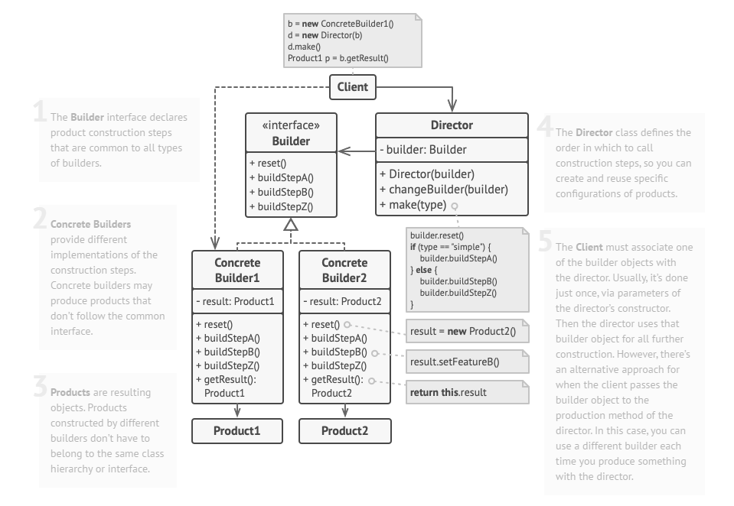
Structure

Slide 16
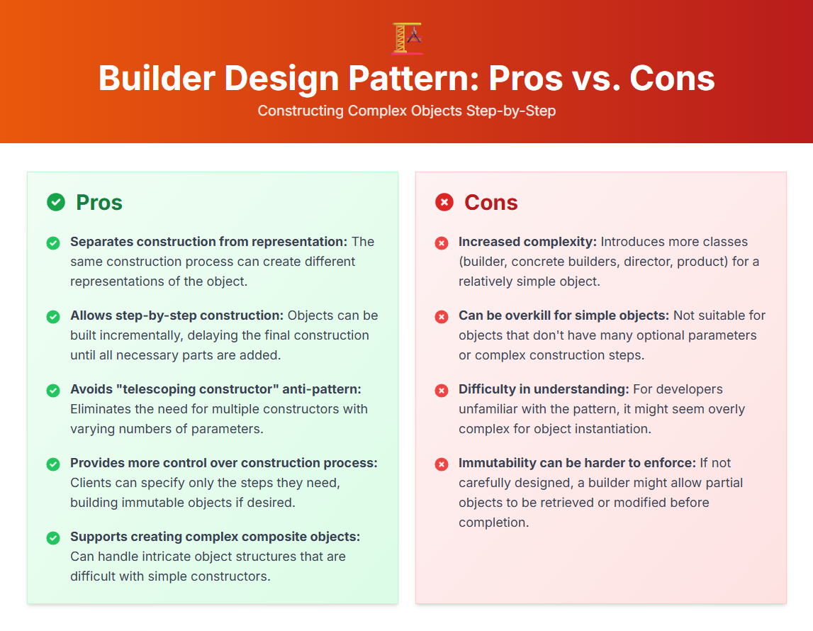

Slide 17
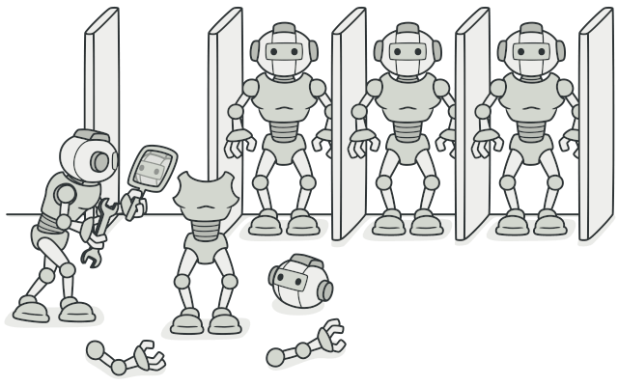
RPOTOTYPE Prototype is a creational design pattern that lets you copy existing objects without making your code dependent on their classes.
Applicability
Use the Prototype pattern when your code shouldn’t depend on the concrete classes of objects that you need to copy.
Use the pattern when you want to reduce the number of subclasses that only differ in the way they initialize their respective objects.
Use cases: Landing Pages, working models.

Slide 18

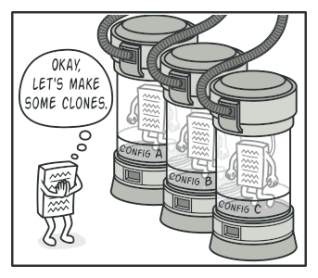
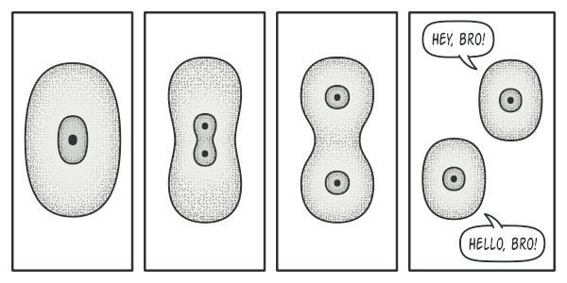
Problem & Solution
Say you have an object, and you want to create an exact copy of it. How would you do it? First, you have to create a new object of the same class. Then you have to go through all the fields of the original object and copy their values over to the new object.
Nice! But there’s a catch. Not all objects can be copied that way because some of the object’s fields may be private and not visible from outside of the object itself.
The Prototype pattern delegates the cloning process to the actual objects that are being cloned. The pattern declares a common interface for all objects that support cloning. This interface lets you clone an object without coupling your code to the class of that object. Usually, such an interface contains just a single clone method.

Slide 19
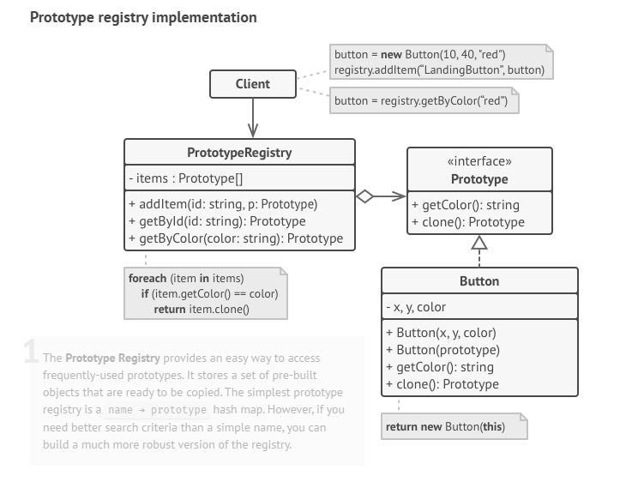
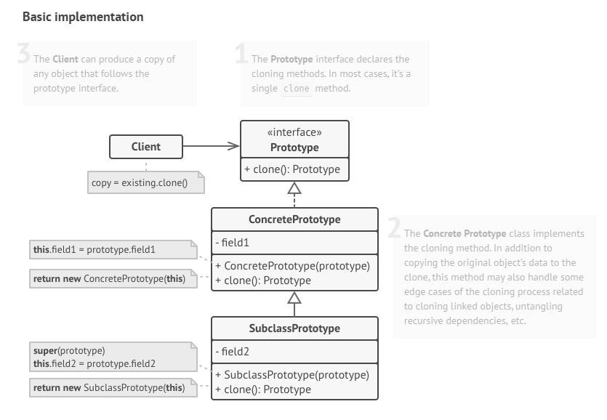
Structure

Slide 20
